Slide 1
CSI3344 Distributed Systems
Lecture 01: Introduction to Distributed Systems
- Introduction to the Unit
1.1 Definition and Examples
1.2 Benefits and Challenges
1.3 General System Model
Major Points
Reading Guide

Slide 2
Cover
Unit Introduction & coordination
Introduction to Distributed Systems
1.1 Definition and Examples
1.2 Benefits and Challenges
1.3 General System Model
Major Points
Reading Guide

Slide 3
Introduction to CSI3344
Staff Contact Details
Dr Jitian XIAO
Unit coordinator/lecturer/tutor
Office: JO 18.340
Tel: 6304 6056
email: j.xiao@ecu.edu.au
Further information
CSI3344 Distributed Systems

Slide 4
Introduction to CSI3344
Unit Content:
Characterisation of distributed systems
Design considerations for distributed systems
Architectures of distributed systems
Communication protocols
Remote procedure calls and remote method invocations
Distributed naming services
Synchronization and concurrency control
Consistency protocols and distributed replication
Fault handling techniques
Distributed system security
Middleware technology
Paradigms of distributed systems
CSI3344 Distributed Systems

Slide 5
Introduction to CSI3344
2-hour lecture + 1-hour workshop
Textbook
Distributed Systems: Principles and Paradigms, 2nd ed. By Tanenbaum & Van Steen (2014), Pearson Education
e-version is ok
Seminar Slides, Weekly Review Questions, and other materials available on Blackboard at: http://blackboard.ecu.edu.au/
CSI3344 Distributed Systems

Slide 6
Introduction to CSI3344
Unit Assessment
Assignment 1 – weekly workshops 20%
Assignment 2 – report 30%
Examination 50%
Close-book exam
Notes:
This unit require students achieve at least 50% of the exam marks to be eligible to pass the unit.
Collusion, cheating and plagiarism are NOT ACCEPTABLE.
SEVERE PENALTY applies
CSI3344 Distributed Systems

Slide 7
Assignments
Assignment 1 (20%)
Complete 10 out of 11 workshops (each carried 2 marks)
Each workshop has 2~5 questions, mainly from the text
Weekly based tasks: Need to submit your solution/s weekly, before sample solution is uploaded on to BB
Sample solutions will be uploaded on to BB in 1 week from the due date/time of the workshop submission.
A1 result to be released in week 13 (last teaching week)
Assignment 2 (30%)
Report & Seminar: Choose one: a report, or a mini project
Report due in week 11, seminar presentation in week 12~13
CSI3344 Distributed Systems
Notes:
Let me know if you prefer 2 hours exam or 3-hours one?

Slide 8
Study Guide
Attend the lectures regularly
Must read your textbook
Only attending the class is not enough
Pre-lecture reading – bring your questions into class
Post-lecture reading – review and link the contents together
2-4 extra hours study for each module
Attempt all workshop exercises
Attempt all review questions
Do your best for your A2

Slide 9
Plagiarism
Copying other peoples work
Not citing sources/references
Submitting other peoples work
Not worth the gamble – usually results in 0 mark for the assessment (1st offence), and the unit (2nd offence)
Check Donald McDemid’s material on plagiarism (Downloadable from Week 1)
Always ask you tutor / lecturer if you’re unsure
“I’ve never heard of plagiarism” is not a defense
Definitions of plagiarism can be found here:
http://intranet.ecu.edu.au/__data/assets/pdf_file/0014/20624/plagiarism.pdf
Also Look at the section Essential Information on the Overview section on BB
CSI3344 Distributed Systems

Slide 10
Contacting Staff?
Any Concerns:
Should talk to your tutor in the first instance so to work together towards a suitable solution.
Don’t wait until too late.
Email your tutor who will make every attempt to deal with the problem/concern as soon as possible. Set up subsequent meetings if needed.
Email: Please put the unit code, CSI3344, in the Subject line; and your name, and/or Person ID, in body of the message
Phone call: if not attended, leave your message
Personal Problem: see the tutor (if you feel it is something that you can discuss with the tutor) or the Student Counselor.
CSI3344 Distributed Systems

Slide 11
Regarding Occupational Safety & Health
Take note of the exit points in case of Emergency
Go through the slides on Occupational Safety & Health – provided by Dr Steve Hinckley (Download it from Module 01)
Alarms
Warning
Evacuation
Assembly points
Lab safety
Enclosed footwear only
CSI3344 Distributed Systems

Slide 12
Regarding Extensions to Assignments
Extensions will only be considered where supporting documents/evidence is provided
Medical certificate; Note from Student Counselor;
Work, Travel and assignments of other unit/s not grounds for extensions
If an extension is to be granted,
Maximum 5 days within unit coordinator’s capacity. Further extension needs approval from Head of School
Rules for extensions can be found at http://intranet.ecu.edu.au/student/my-studies/study-advice/assignments
CSI3344 Distributed Systems

Slide 13
– Etiquette
All questions are welcome, but please no personal conversation during lecture/tutorials
Turn off your mobile or set it in silent mode
NOTE: if you have a special reason that you need to leave the phone on, please let the lecturer know at the beginning of the seminar
Thank you in advance for your consideration of other students in these matters
MOBILE TELEPHONES AND PAGERS (FROM THE STUDENT HANDBOOK)
Although students may take mobile telephones into libraries, lecture rooms, and tutorial rooms, as a courtesy to other students, they must ensure that the devices are switched off and not able to cause disruption to classes, or to other students attempting to pursue their studies. Mobile telephones and pagers are not permitted in examination rooms to ensure security and the integrity of the university examination.
CSI3344 Distributed Systems

Slide 14
– Supp Exams & Deferred Exam
The rules for conceded pass (CP) and/or supplementary exams change from time to time
CP and Supps are determined by the Board of Examiners of the school, NOT by the unit/course coordinator or HoS
Details at: http://www.ecu.edu.au/GPPS/legal_legis/uni_rules.html
Deferred Exam: need to apply for it at or before the normal exam date/time unless emergency.
If you were sick on the day of the exam, you should see a doctor, get a medical certificate and then immediately apply for a deferred exam.
CSI3344 Distributed Systems

Slide 15
Consultation Time
Free consultation time
Monday 16:00 – 17:00
Thursday 13:00 – 15:00
Frisday 13:00 – 15:00
Other time possible, by appointment via email
To avoid disappointment, email to make appointment beforehand.
CSI3344 Distributed Systems

Slide 16

Now, any questions …?
CSI3344 Distributed Systems

Slide 17
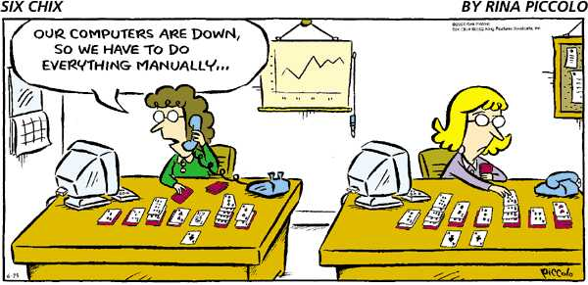
Now let’s play with …
CSI3344 Distributed Systems

Slide 18
Lecture 01
Introduction to
Distributed Systems

Slide 19
Objectives of this lecture
Be aware of the arguments on definitions of distributed systems;
Give examples of distributed systems;
Discuss the benefits provided by distributed systems;
Discuss the challenges in distributed system design and construction;
Be familiar with the general system models of distributed systems;
Be familiar with middleware position in and services to distributed systems.
CSI3344 Distributed Systems

Slide 20
1.1 Definition and Examples (1)
Tanenbaum & van Steen (2007):
A distributed system (DS) is a collection of independent computers that appears to its users as a single coherent system.
This definition addresses that:
Machines are autonomous;
Users think they are dealing with a single system - transparency.
Issues with this definition:
How does the system work? - concurrency
What is the purpose of using a DS? – communication to …
CSI3344 Distributed Systems
Notes:
A distributed system is a piece of software that ensures
that:
a collection of independent computers appears
to its users as a single coherent system
Two aspects: (1) independent computers and
(2) single system - middleware.

Slide 21
1.1 Definition and Examples (2)
Coulouris et al (2001):
A distributed system is a system in which hardware and software components located at networked computers communicate and coordinate their actions only by passing messages.
This definition addresses that:
A network is for passing messages – communications;
The system coordinates all the actions - concurrency.
Issue with this definition:
How does the system appear to its users? - transparency
CSI3344 Distributed Systems
Notes:
AnotherDefinition: A distributed system consists
of a collection of autonomous computers,
connected through a network and
distribution middleware, which enables
computers to coordinate their activities
and to share the resources of the system,
so that users perceive the system as a
single, integrated computing facility (1997)

Slide 22
1.1 Definition and Examples (3)
Both previous definitions only focus on COMPUTERS!
An alternative definition (combination of both):
A distributed system is a collection of independent devices that appears to its users as a single coherent system, in which networked components communicate and coordinate their actions only by passing messages.
This definition covers the four important issues of any distributed system: networked communications, concurrency, transparency, and independent failure.
CSI3344 Distributed Systems
Notes:
Wolfgang Emmerich (1997): Definition: A distributed system consists of a collection of autonomous computers, connected through a network and distribution middleware, which enables computers to coordinate their activities and to share the resources of the system, so that users perceive the system as a single, integrated computing facility.

Slide 23
1.1 Definition and Examples (4)
Example 1: A typical portion of Internet - Hardware
intranet
%
ISP
%
%
%
backbone
satellite link
desktop computer:
server:
network link:
CSI3344 Distributed Systems
Notes:
ISP = Internet service provider

Slide 24
1.1 Definition and Examples (5)
Example 2: Portable and handheld devices in a
distributed system - Hardware
Internet
Host intranet
WAP
Home intranet
Wireless LAN
gateway
Mobile
phone
Printer
Laptop
Camera
Host site
CSI3344 Distributed Systems
Notes:
WAP? - Wireless Application Protocol? (also: Wireless access point )
A WAP gateway sits between mobile devices using the WAP protocol and the World Wide Web, passing pages from one to the other much like a proxy. This translates pages into a form suitable for the mobiles, for instance using the Wireless Markup Language (WML). This process is hidden from the phone, so it may access the page in the same way as a browser accesses HTML, using a URL (for example, http://example.com/foo.wml), provided the mobile phone operator has not specifically prevented this.

Slide 25
1.1 Definition and Examples (6)
Example 3: Distributed services – Software system
Electronic mail – SMTP (Simple Mail Transport Protocols)
News – NNTP (Network News Transport Protocols)
File Transfer – FTP (File Transfer Protocols)
The World Wide Web – HTML/XML + HTTP (HyperText Transfer Protocols)
Electronic payment
Distributed transaction processing
Distributed real-time processing
CSI3344 Distributed Systems

Slide 26
1.2 Benefits and Challenges (1)
1.2.1 Benefits (1)
1) Shareability: the ability the comprising systems to use each other’s resources. -- The sharing of resources (hardware, software and information) is a main motivation for constructing distributed systems. -- Resources may be managed by servers and accessed by clients, or they may be encapsulated as objects and accessed by other client objects.
CSI3344 Distributed Systems

Slide 27
1.2 Benefits and Challenges (2)
1.2.1 Benefits (2)
2) Expandability: the ability that permits new systems to be added as members of the overall system.
--This not only brings more sharing resources into the system, but also allows more users to share both the existing and new resources.
CSI3344 Distributed Systems

Slide 28
1.2 Benefits and Challenges (3)
1.2.1 Benefits (3)
3) Local Autonomy means that a distributed system is responsible for managing its resources.
-- It can apply local policies, settings, and access controls to its resources and services.
4) Improved Performance: A distributed system allows resources to be distributed in different machines. Requests for these resources are sent to different machines, making the processing more efficient.
CSI3344 Distributed Systems

Slide 29
1.2 Benefits and Challenges (4)
1.2.1 Benefits (4)
5) Improved Reliability and Availability: In a distributed system resources are spread or replicated across multiple computers. A disruption might cause only minimum impact on the system.
6) Potential Cost Reduction. It’s obvious but not always!
CSI3344 Distributed Systems

Slide 30
1.2 Benefits and Challenges (5)
1.2.2 Challenges (1)
1) Heterogeneity: A distributed system should allow users to access services and run applications over a heterogeneous collection of computers and networks.
Heterogeneity applies to
Networks
Computer hardware
Operating systems
Programming languages
Application implementations by different developers
CSI3344 Distributed Systems

Slide 31
1.2 Benefits and Challenges (6)
1.2.2 Challenges (2)
2) Openness: A distributed system should allow the system to be extended and re-implemented in various ways.
- It is measured primarily by the degree to which new resource- sharing services can be added without disruption or duplication of existing services, and be made available for use by a variety of client programs.
Two perspectives:
Hardware extensibility
Software extensibility
CSI3344 Distributed Systems

Slide 32
1.2 Benefits and Challenges (7)
1.2.2 Challenges (3)
3) Security: A distributed system should not only allow its users to share resources more easily, but also protect these resources against any unauthorized activities with them.
Security for data resources has three components (CIA):
Confidentiality (against disclosure to unauthorized individuals)
Integrity (against alteration or corruption)
Availability (against interference with the means to access the resources)
CSI3344 Distributed Systems

Slide 33
1.2 Benefits and Challenges (8)
1.2.2 Challenges (4)
4) Scalability: Scalability in a distributed system is the characteristic where a system remains effective when there is a significant increase in the number of resources and the number of users.
CSI3344 Distributed Systems

Slide 34
1.2 Benefits and Challenges (9)
1.2.2 Challenges (5)
5) Failure handling: Failures in a distributed system should be partial, i.e., some components fail while others continue to function. Distributed systems provide a high degree of availability in the face of hardware faults.
- The availability of a system is a measure of the proportion of time that is available for use.
Techniques for handling failures include:
* Detecting failures * Masking failures
* Tolerating failures * Recovery from failures
* Redundancy
CSI3344 Distributed Systems

Slide 35
1.2 Benefits and Challenges (10)
1.2.2 Challenges (6)
6) Concurrency: the ability to process multiple tasks at the same time.
7) Transparency:
is defined as the concealment of the separation of components in a distributed system so that the system is able to present itself to users and applications as if it were only a single computer system.
measured by different type of transparencies (at least 8 types – see following slides)
CSI3344 Distributed Systems

Slide 36
1.2 Benefits and Challenges (11)
1.2.2 Challenges (7)
Transparency (cont)
Access transparency: enables local and remote resources to be accessed using identical operations.
Location transparency: enables resources to be accessed without knowledge of their location.
Access + Location = Network transparency
Concurrency transparency: enables several processes to operate concurrently using shared resources without interference between them.
CSI3344 Distributed Systems

Slide 37
1.2 Benefits and Challenges (12)
1.2.2 Challenges (8)
Transparency (cont…)
Replication transparency: enables multiple instances of resources to be used to increase reliability and performance without knowledge of the replicas by users or application programmers.
Failure transparency: enables the concealment of faults, allowing users and application programs to complete their tasks despite the failure of hardware or software components.
CSI3344 Distributed Systems

Slide 38
1.2 Benefits and Challenges (13)
1.2.2 Challenges (9)
Transparency (cont…)
Mobility transparency: allows the movement of resources and clients within a system without affecting the operation of users or programs.
Performance transparency: allows the system to be reconfigured to improve performance as loads vary.
Scaling transparency: allows the system and applications to expand in scale without change to the system structure or the application algorithms.
CSI3344 Distributed Systems

Slide 39
1.3 General System Model (1)
1.3.1 System model (1)
Distributed systems are often organized as layered structure
Applications, services
Middleware
Operating system
Platform
Computer and network hardware
CSI3344 Distributed Systems

Slide 40
1.3 General System Model (2)
1.3.1 System model (2)
Platform
This lowest layer provides services to the layers above them, which are implemented independently in each computer. Each local OS, which forms part of the underlying network OS, should provide local resource management and communication means to other computers.
Major examples
Intel x86/Windows
Intel x86/Linux
Intel x86/Solaris
SPARC/SunOS
PowerPC/MacOS
CSI3344 Distributed Systems

Slide 41
1.3 General System Model (3)
The Middleware
This is a type of distributed system software that connects different kinds of applications and provides distributed transparency to its connected applications. Middleware does not manage an individual node.
The purpose is to mask heterogeneity present in distributed systems and to provide a convenient programming model to application developers.
Examples:
Sun RPC (Remote Procedure Calls)
OMG CORBA (Common Object Request Broker Architecture)
Microsoft D-COM (Distributed Components Object Model)
Sun Java RMI
Modern Middleware:
Manjrasoft Aneka– for Cloud computing
IBM WebSphere
Microsoft .NET
Sun J2EE
Google AppEngine
Etc.
CSI3344 Distributed Systems
Notes:
To enable us to be truly platform agnostic, we need a core set of middleware and functions that we can use on all platforms
Sun RPC is available on most Unix platforms
CORBA is a distributed middleware that is available for all major platforms
Java RMI is available on any platform there is a compliant JVM install
.NET is becoming a standard, and is available for Windows/Linux/MacOS
Higher level middleware (Gridbus/Globus) can hide even more complexity

Slide 42
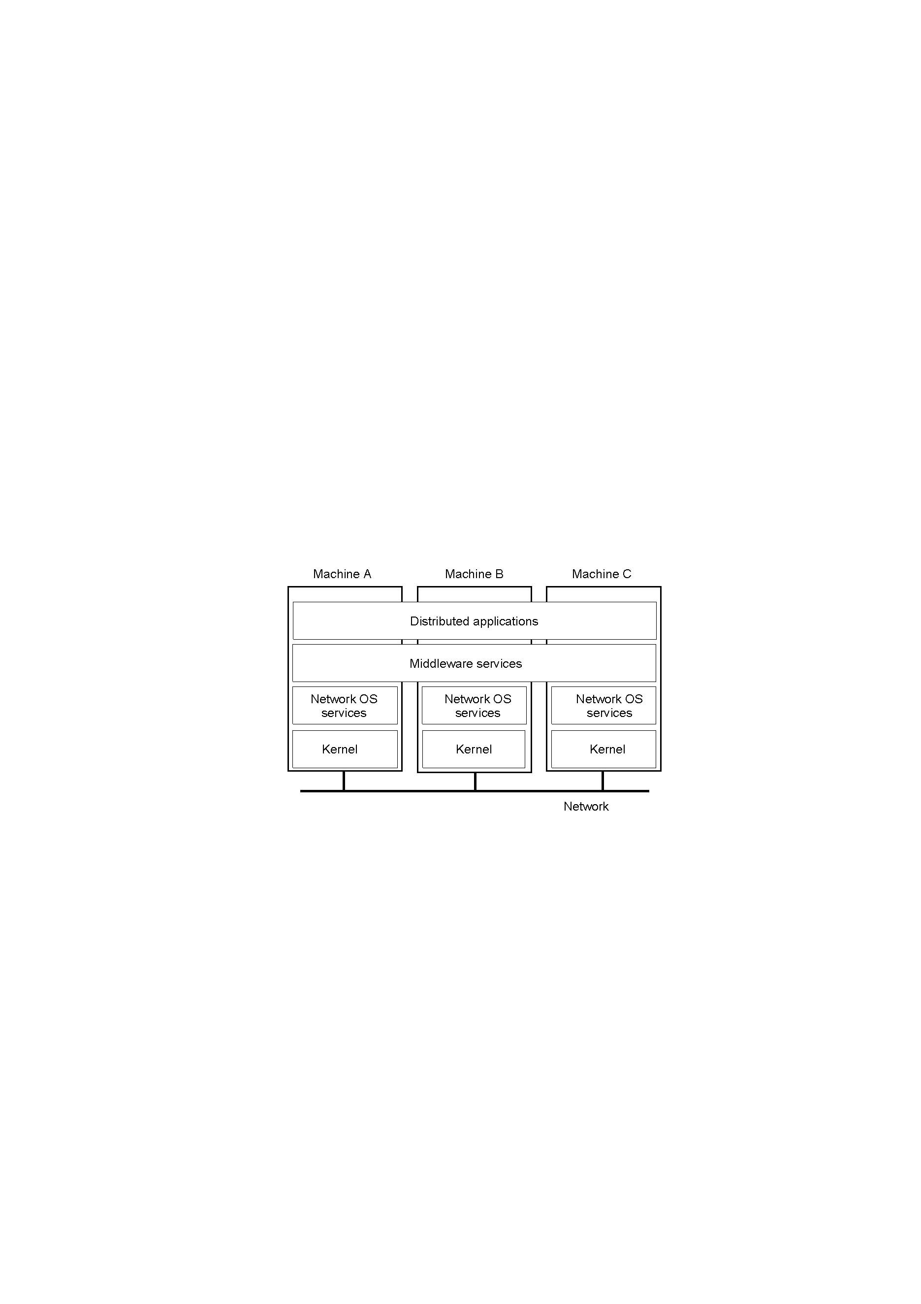
1.3 General System Model (4)
1.3.2 Middleware (1)
Middleware position: between applications and operating system layers
CSI3344 Distributed Systems

Slide 43
1.3 General System Model (5)
1.3.2 Middleware (2)
Middleware models: To make development and integration of distributed applications as simple as possible, most middleware is based on a certain model for describing distribution and communication.
Some early models:
Unix file systems
Everything is treated as a file, and whether a file is local or remote makes no difference.
An application opens a file, reads and writes bytes, and closes it again.
Communication efficiency is reduced when a file is accessed by several processes at the same time.
CSI3344 Distributed Systems

Slide 44
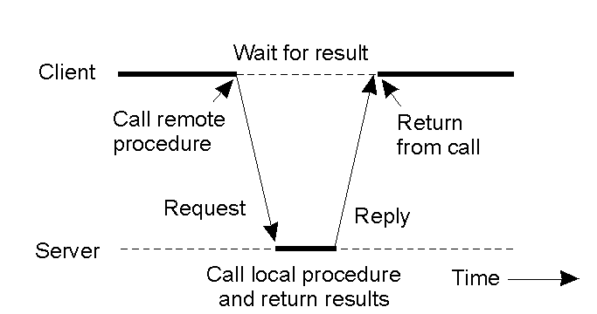
1.3 General System Model (6)
1.3.2 Middleware (3)
Some early models (cont…):
Remote procedure calls (RPCs)
The emphasis is on hiding network communication by allowing a process to call a procedure being executed on a remote machine.
The calling process remains unaware of the fact that the network communication took place.
CSI3344 Distributed Systems

Slide 45
1.3 General System Model (7)
1.3.2 Middleware (4)
Recent models:
Distributed objects
A middleware model based on distributed objects should be able to hide not only network communication offered by RPCs, but also to invoke objects residing in remote machines in a transparent fashion.
Each object implements an interface that hides all the internal details of the object from its user. The only thing that a process sees of an object is its interface.
CSI3344 Distributed Systems

Slide 46
1.3 General System Model (8)
1.3.2 Middleware (5)
Recent models (cont…) :
Distributed documents (WWW)
Information is organized into documents, with each document residing at a machine transparently located somewhere in the world.
Documents contain links that refer to other documents. By following a link, the document to which that link refers to is fetched from its location and displayed on the user’s screen.
CSI3344 Distributed Systems

Slide 47
1.3 General System Model (9)
1.3.2 Middleware (6)
Middleware services
Communication services
Middleware offers high-level communication services that hide the low-level message passing through computer networks.
Naming
Name services allow entities to be shared and looked up (as in directories), similar to phone books.
CSI3344 Distributed Systems

Slide 48
1.3 General System Model (10)
1.3.2 Middleware (7)
Middleware services (cont…):
Persistence
Many middleware systems offer special facilities for storage, referred to as persistence.
Distributed transactions
Many middleware systems offer special facilities for distributed transactions. Distributed transaction services allow multiple read and write to occur atomically, i.e., a transaction either succeeds, so that all its write operations are actually performed, or fails, leaving all referenced data unaffected.
Security – (to be covered in Module 10)
CSI3344 Distributed Systems
Notes:
Persistence - Continuance of an effect after the cause is removed:

Slide 49
Major Points
Distributed system basis – some terminologies
Benefits provided by Distributed Systems
Challenges in Distributed System design and construction
System Model:
Applications + Middleware + Platform
Middleware position
Middleware services
.
CSI3344 Distributed Systems

Slide 50
Reading Guide
DSPP (textbook)
Chapter 1: Sections 1.1, 1.2, and 1.4.3
DSCD (reference text)
Chapter 1: (all sections)
Chapter 2: Section 2.2.1
Where
DSPP: Distributed Systems: Principles and Paradigms (Tanenbaum & Van Steen, 2014)
DSCP: Distributed Systems: Concepts and Design (Coulouris, Dollimore, & Kindberg, 2001)
CSI3344 Distributed Systems

